Slide 1
COSMOS: Cluster #11 Intro to Autonomous Vehicles
Introduction to OpenCV Python
Moises Lopez
ECE Grad Student

Slide 2
Please download and install VSCode
Install Python
And Python plugin in VSCode
Download OpenCV Tutorial from the student folder

Slide 3
Outline:
Introduction to various functions in OpenCV
Discussing different approaches for lane detection and Navigation ( HoughLines, Color Segmentation, Perspective Transform)
Setup Setup local computer for using Python and OpenCV
Implementation of OpenCV on test images for successful lane detection
If time permits, then do lane detection on video.

Slide 4

OPEN CV:
OpenCV (Open-Source Computer Vision Library) is an open-source computer vision and machine learning software library. OpenCV was built to provide a common infrastructure for computer vision applications and to accelerate the use of machine perception in the commercial products. It supports various programming languages like Python, C++ and Java.
Some of the widely used areas of application are:
Object Detection
Facial Recognition
Image processing
Perception in Robotics
3D reconstruction
Open-cv documentation

Slide 5
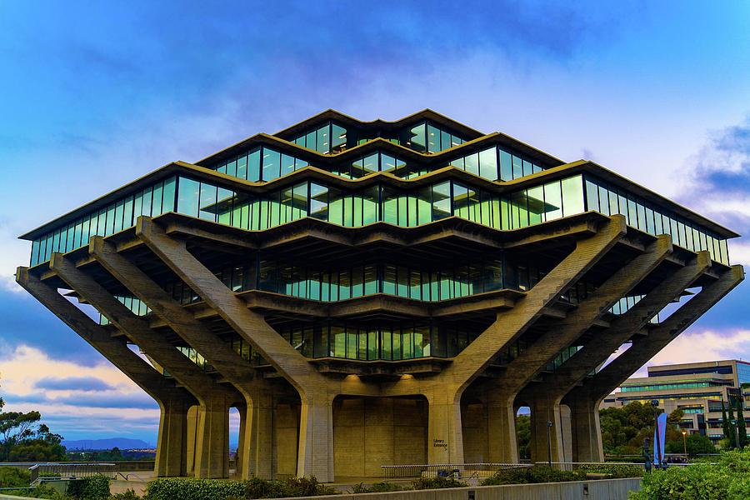
Image and Resolution:
An image is nothing but a matrix in its digital representation where each pixel of the image corresponds to an element of the matrix.
Resolution of the images represents the number of pixels along height and width.
A colored image is represented by a 3d matrix with number of channels i.e, ( number of pixels in y direction * number of pixels in x direction *3)
Color of a particular pixel is determined by the numbers present in all the dimensions at that particular pixel location.
There are many color space representations and colors defined in them. Widely used color space in digital photography is RGB. (RED, GREEN , BLUE).

Slide 6
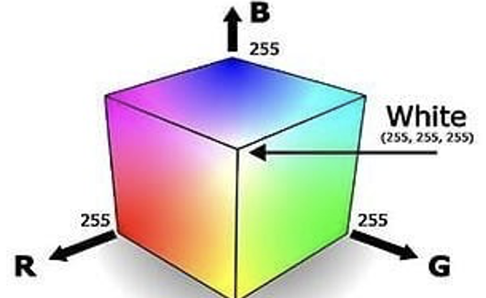
Color Spaces:
Generally, all the color spaces have 3 defining parameters. In 8-bit representation of RGB color spaces each of the parameters R,G,B can take values from 0-255 giving as a total of 255*255*255 different combinations of colors.! (About 16 million combinations)
The RGB color space has the following properties
It is an additive color space where colors are obtained by a linear combination of Red, Green, and Blue values.
The three channels are correlated by the amount of light hitting the surface.

Slide 7
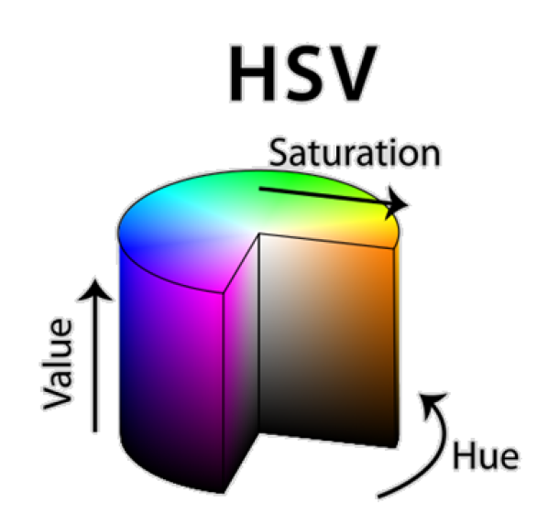
HSV Color Space:
HSV Color Space follows cylindrical coordinate system with the axes being :
Hue (H): Dominant Wavelength : angular dimension (red 0 , green 120 , blue 240 )
Saturation (S): ( Purity / shades of the color ) : pure red has saturation 1, while tints have saturation < 1
Value/Brightness (V): ( Intensity )achromatic/gray colors ranging from black
(V = 0, bottom) to white (V = 1, top)
Best thing is that it uses only one channel to describe color (H), making it very intuitive to specify color.
Device dependent.

Slide 8
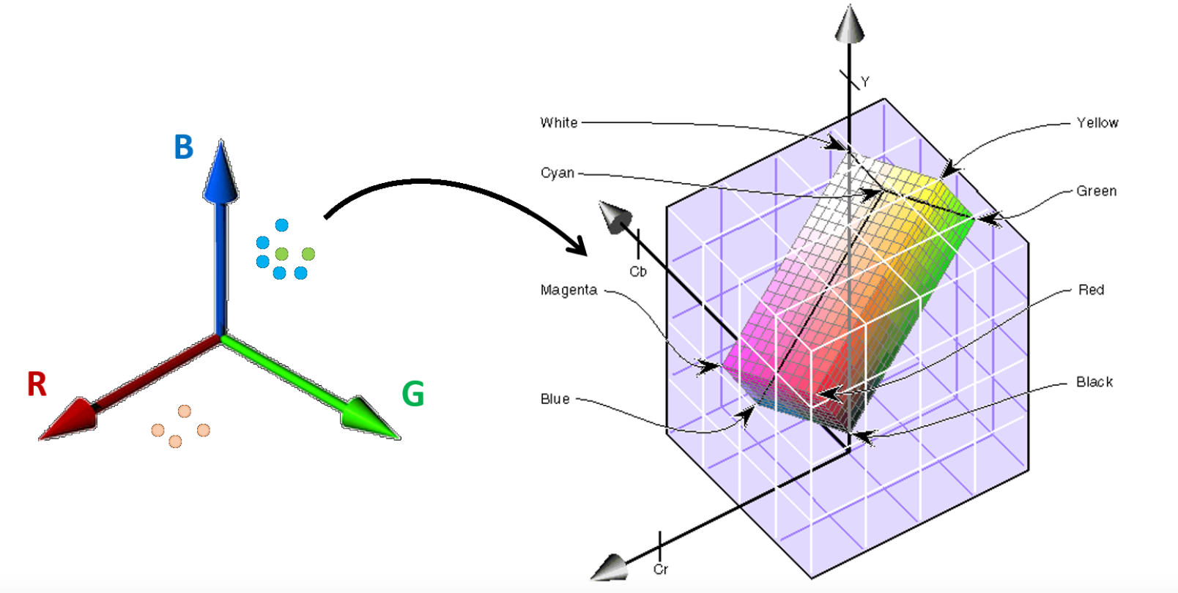
Luma-Chroma Color Space: (YCbCr)
Luminance/Brightness (Y) = (R + G + B)/3
Blueness (U/Cb) (B - G)
Redness (V/Cr) (R - G)

Slide 9
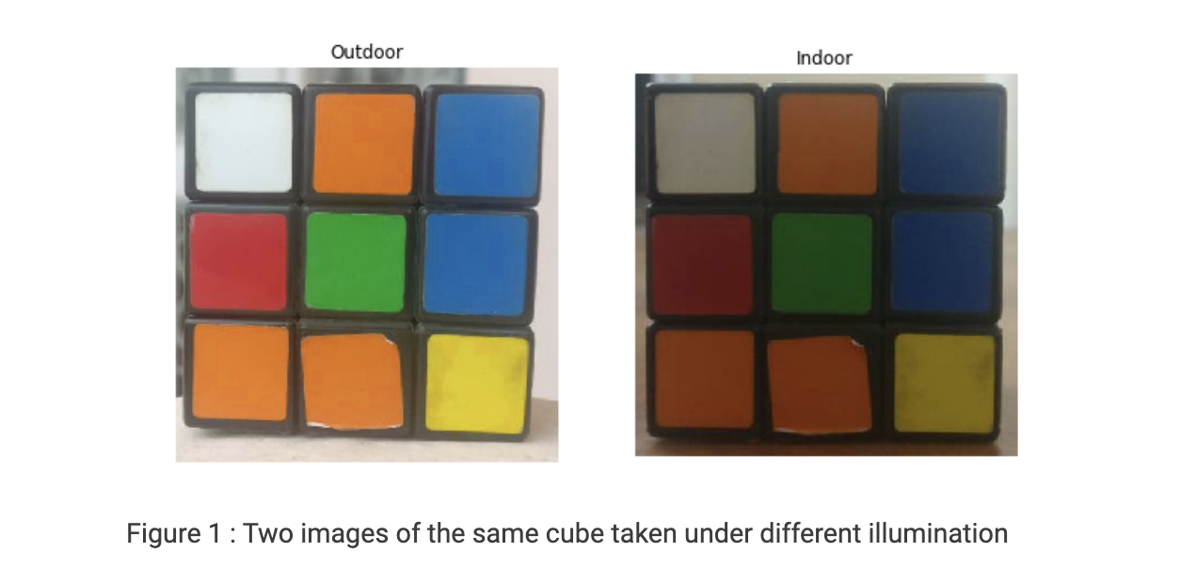
Why different Color Spaces:

Slide 10
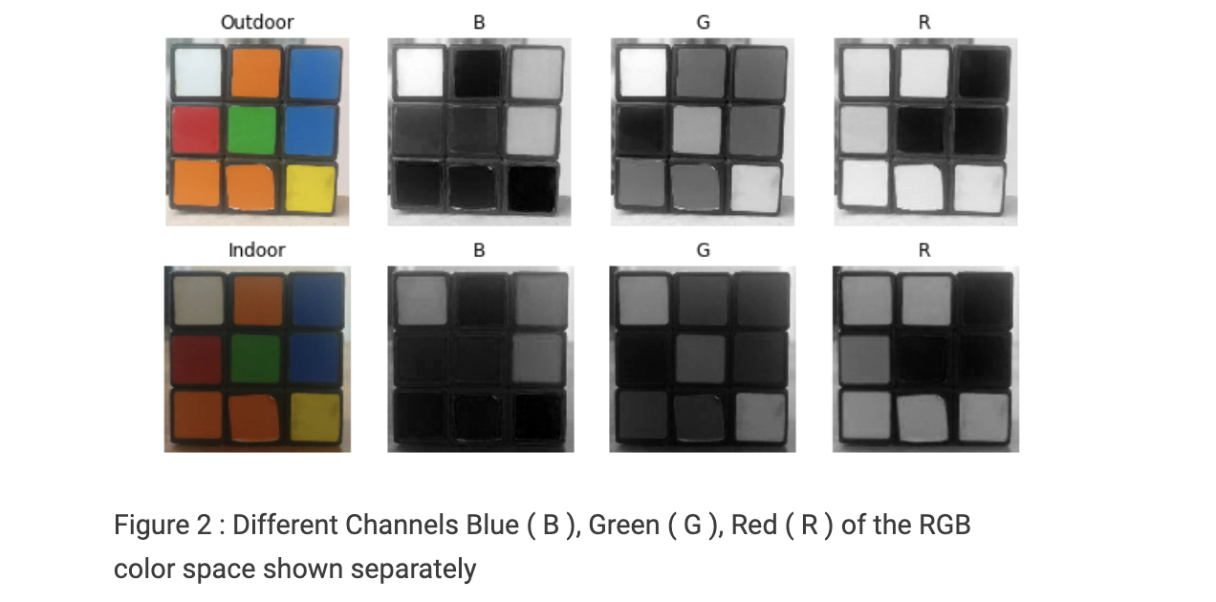
If you look at the blue channel, it can be seen that the blue and white pieces look similar in the second image under indoor lighting conditions but there is a clear difference in the first image. Further, there is an overall difference between the values of the two images. The inherent problems associated with the RGB Color space:
significant perceptual non-uniformity.
mixing of chrominance ( Color related information ) and luminance ( Intensity related information ) data.

Slide 11
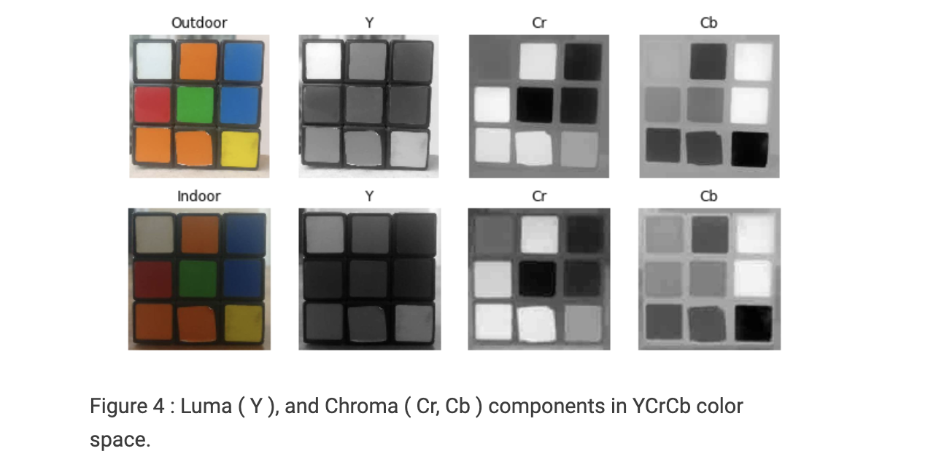
It is pretty clear from the figure that the change in illumination has mostly affected the Y component.
Perceptual difference between Red and Orange is less even in the outdoor image as compared to LAB.
White has undergone change in all 3 components.

Slide 12
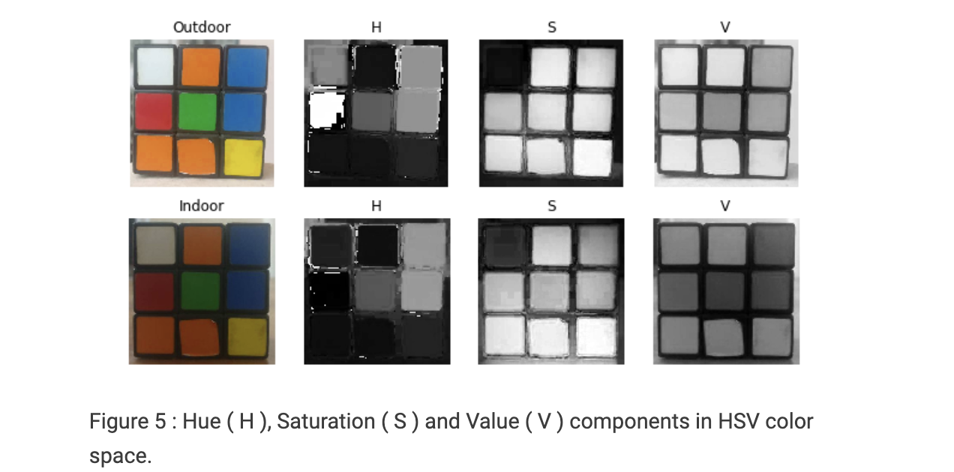
The H Component is very similar in both the images which indicates the color information is intact even under illumination changes.
The S component is also very similar in both images.
The V Component captures the amount of light falling on it thus it changes due to illumination changes.

Slide 13
Open CV Functions:
There are hundreds of functions defined in OpenCV facilitating various operations that can be carried out on images. Each of the functions has set of default arguments, a set of mandatory arguments. Detailed documentation of the functions is available at open cv documentation for all the languages.
Syntax: cv2.imread(path, flag)
Parameters: path: A string representing the path of the image to be read. flag: It specifies the way in which image should be read. It’s default value is cv2.IMREAD_COLOR
Return Value: This method returns an image that is loaded from the specified file.
Generally, the flag argument is not used and there are other popular ways to achieve grayscale images. The detailed syntax is provided here just for your understanding.
cv2.IMREAD_COLOR: It specifies to load a color image. Any transparency of image will be neglected. It is the default flag. Alternatively, we can pass integer value 1 for this flag. cv2.IMREAD_GRAYSCALE: It specifies to load an image in grayscale mode. Alternatively, we can pass integer value 0 for this flag. cv2.IMREAD_UNCHANGED: It specifies to load an image as such including alpha channel. Alternatively, we can pass integer value -1 for this flag.
Notes:
Alpha channel is transparency.

Slide 14
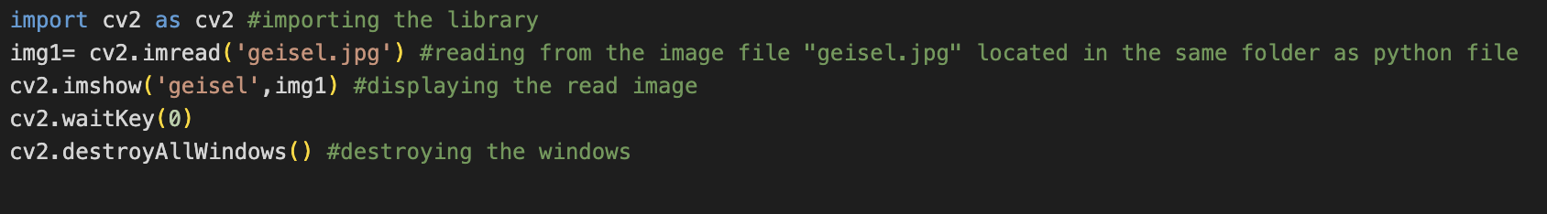
New functions:
cv2.imread(‘file_name.ext’)
cv2.imshow(‘plot_name’, image)
Cv2.waitKey(0)

Slide 15
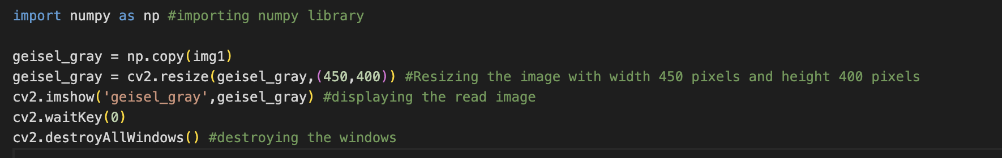

Copy and Resize
New functions: np.copy(image)
cv2.resize(image,(width,height))

Slide 16
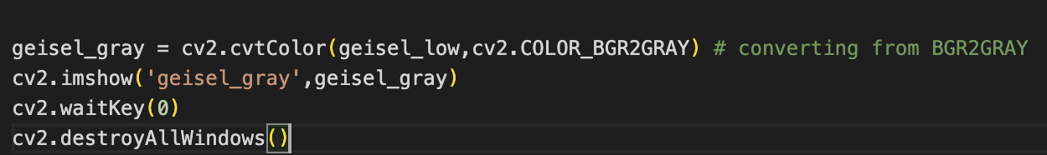
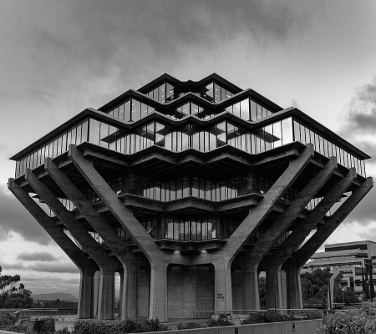
Convert to GrayScale
In digital images, grayscale means that the value of each pixel represents only the intensity information of the light. Such images typically display only the darkest black to the brightest white. In other words, the image contains only black, white, and gray colors, in which gray has multiple levels
New functions: cv2.cvtColor(image,cv2.COLOR_BGR2GRAY)

Slide 17
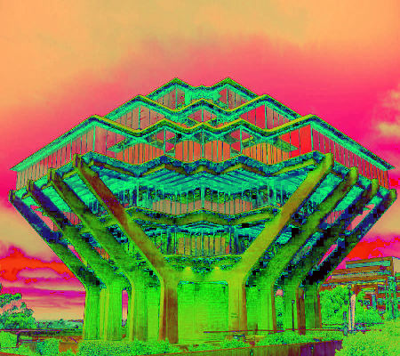
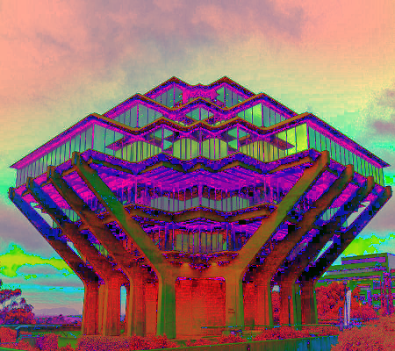
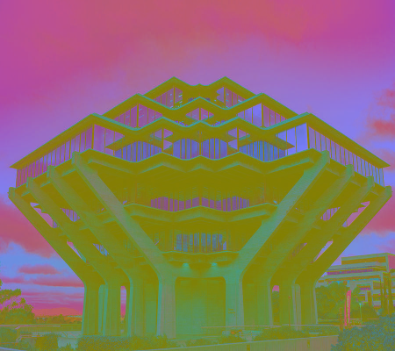
Color Space Conversions:
OpenCV provides functions for converting images between different color spaces
BGR 2 HSV
BGR2HSL
BGR2YCbCr
Notes:
L = lightness
Y = Luma = brightness

Slide 18
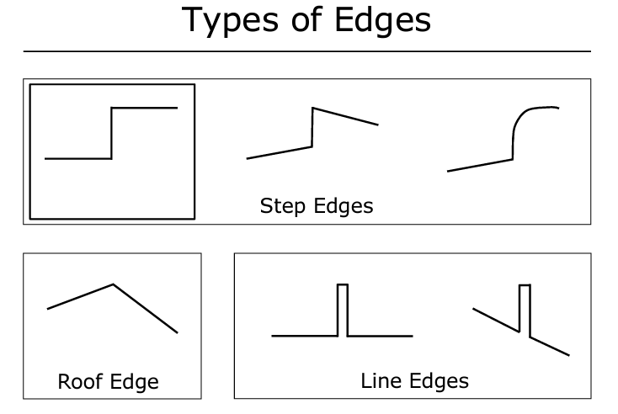
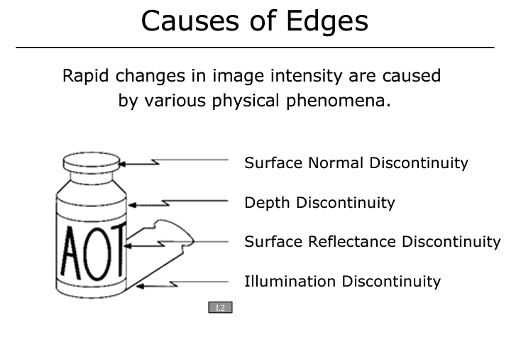
Edge Detection:
Edge: Rapid change in image intensity within small region. Since an edge can best identified based on the intensity, we refer to the grayscale images for Edge detection.
Exact location of an edge can even lie within a pixel. We therefore would like to find edges with sub-pixel accuracy.

Slide 19
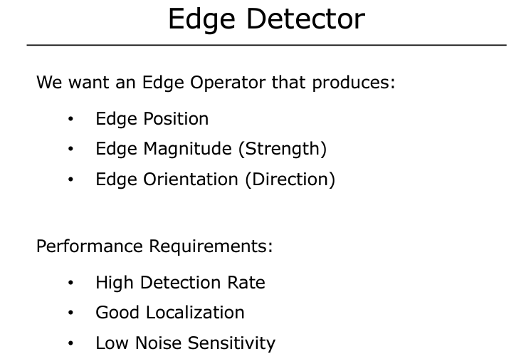
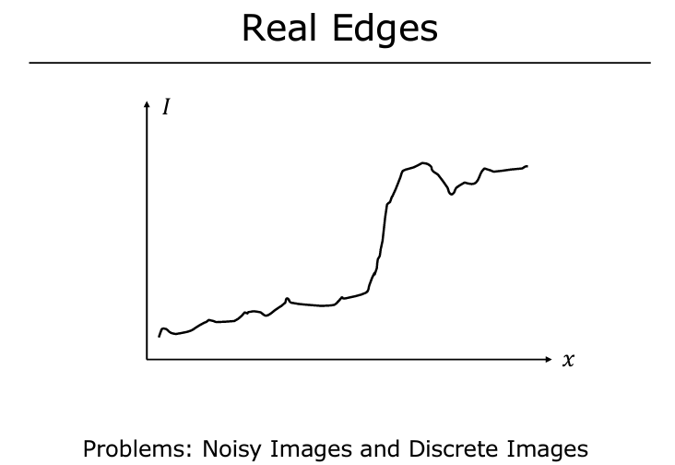

Slide 20
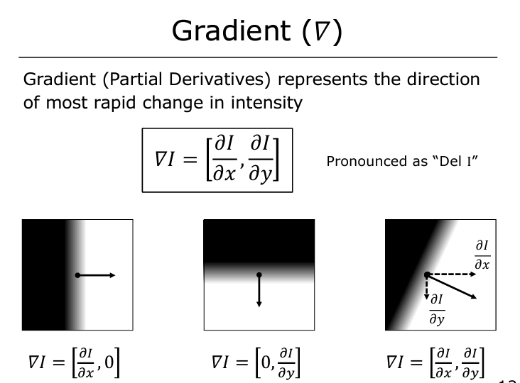
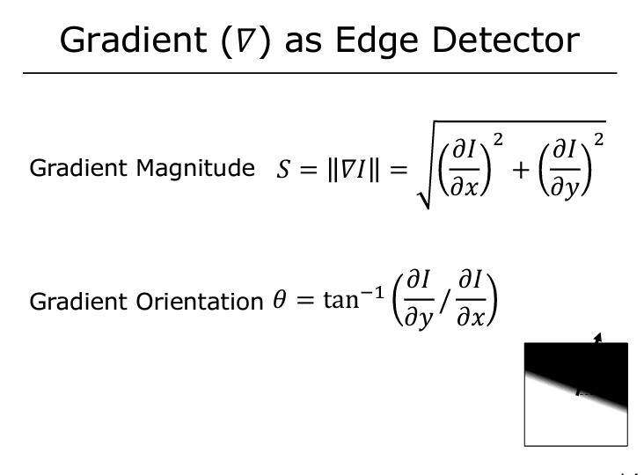
Open CV provide an operator called “Sobel” operator that determines edges based on gradient

Slide 21
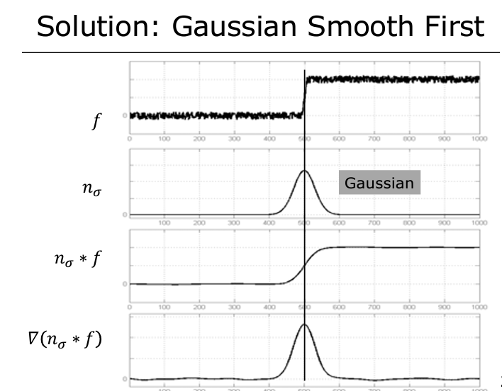
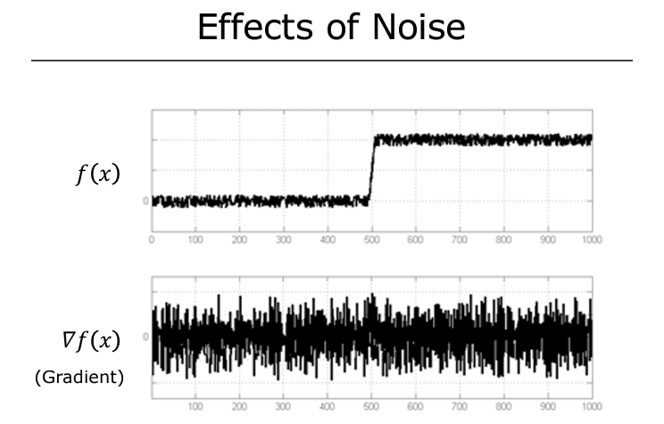
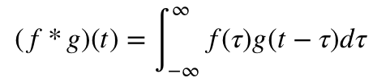
Image Smoothening:

Slide 22
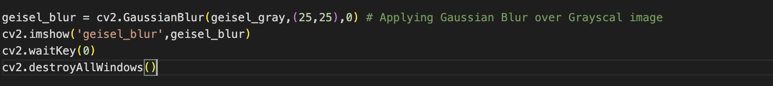

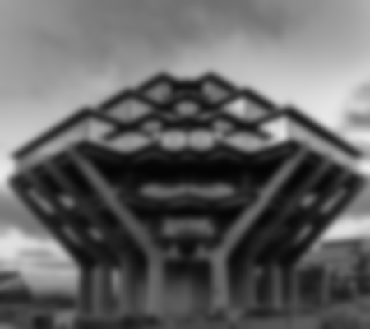
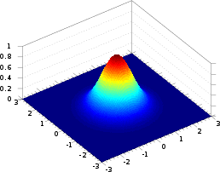
Smoothen Image
New functions: cv2.GaussianBlur(image,(kernel_size),sigma)
Gray
Blur (5x5)
Blur (25x25)

Slide 23
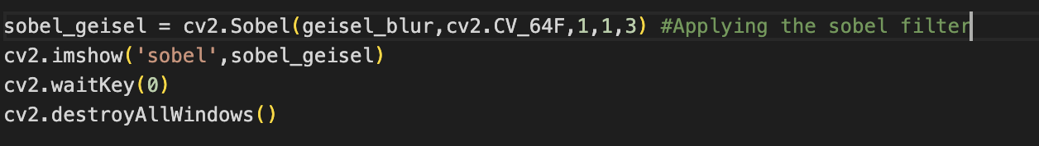
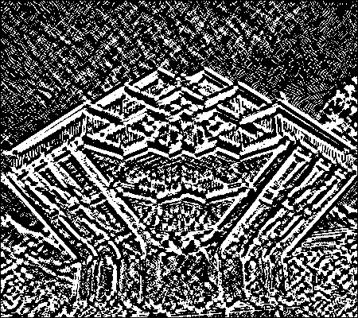
Sobel and Canny:
New functions:
cv2.Sobel( image,xorder,yorder,kernel_size)

Slide 24
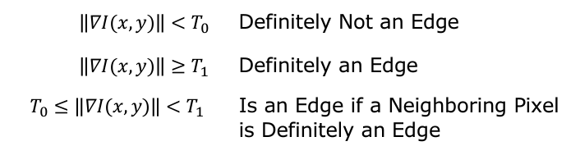

Canny Filter
0 | 0 | 255 | 255
0 | 0 | 255 | 255
0 | 0 | 255 | 255
0 | 0 | 255 | 255
0 | 0 | 255 | 255
0 | 0 | 25 | 25
0 | 0 | 25 | 25
0 | 0 | 25 | 25
0 | 0 | 25 | 25
0 | 0 | 25 | 25
Large gradient
Small gradient
Edge detection
Reduce Noise using Gaussian Smoothing.
Compute image gradient using Sobel filter.
Apply Non-Max Suppression or NMS to just jeep the local maxima
Finally, apply Hysteresis thresholding which that 2-threshold values T_upper and T_lower which is used in the Canny() function.
Lower threshold
Upper threshold

Slide 25
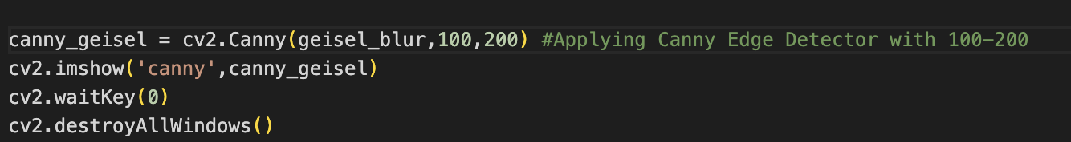
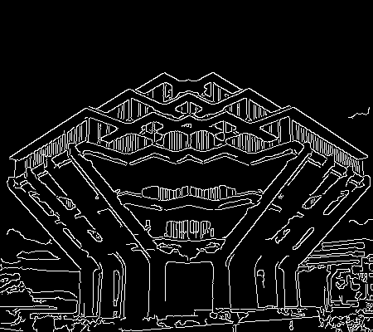
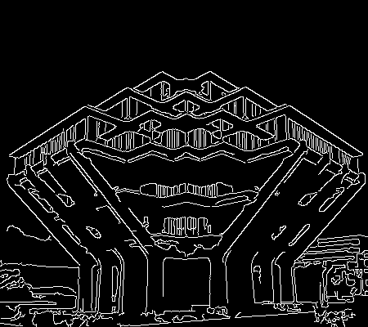
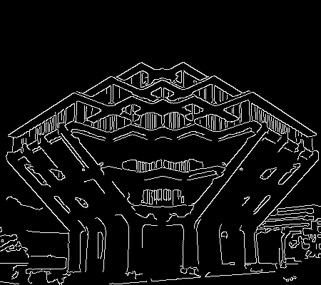
Edge Detection using Canny
New functions:
cv2.Canny(image, lower_threshold, upper_threshold)
Original
Threshold: 50-150
Threshold: 50-200
Threshold: 100-200

Slide 26

Hough Space
y
b
m
b
x
m

Slide 27





Hough Space
y
b
x
m

Slide 28
Hough Space
y
b
x
m

Slide 29
Hough Space
y
b
x
m

Slide 30
Hough Space
y
b
x
m

Slide 31
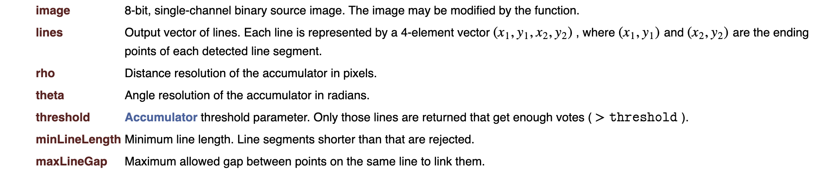
Find Lines using Hough Transformation
Cv2.HoughlinesP(image, length_res, ang_res, threshold, min_length, max_gap)

Slide 32
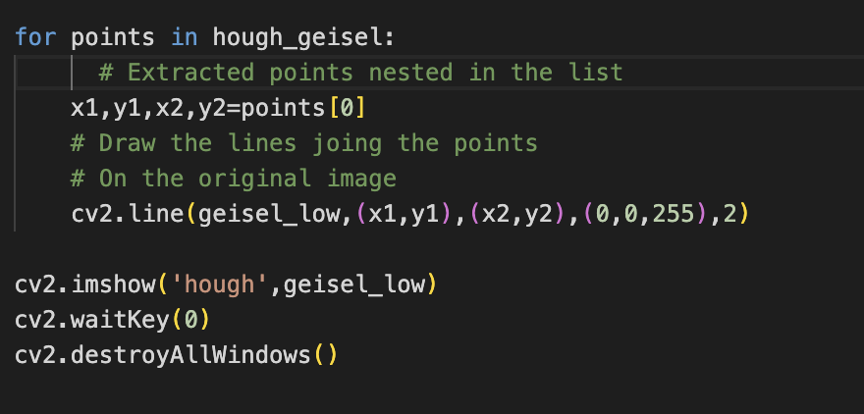

Plotting Detected Lines
New functions:
cv2.line(image, (x1,y1), (x2,y2), color, line_width)

